Slide 1
05 – Review of Inventory and Uncertainties
Geosense
Maximilian Fabi

Slide 2
Agenda What's happening today
1. Review of last week's inventory
2. Introduction to sampling uncertainty
3. Transition to the exercise in R
Results of our Inventory
Sampling uncertainty
Simulation of sampling a Forest

Slide 3
review
The data you recorded and handed in...

Slide 4

Objectives of the field exercise
Getting to know the techniques and uncertainties
Influence of the correct selection of plots
Human factor
Measurement inaccuracy of the instruments used
Influence of the weather ...
AND: Learning to submit data according to specifications is also included here! Sadly only one group managed to do that properly
Anglecount missing, plot ID missing, coordinates missing…
https://img.welt.de/img/wissenschaft/mobile252720180/6597938837-ci23x11-w2000/GettyImages-1437280725.jpg

Slide 5
Results
What could we conclude from the collected data?
https://img.welt.de/img/wissenschaft/mobile252720180/6597938837-ci23x11-w2000/GettyImages-1437280725.jpg

Slide 6
Results
Basal area and volume
Basal area: Sum of the basal areas of all trees on a specific area (m2/ha)
Volume: Cubic meters per hectar (m3/ha)
Proportions of tree species, biomass, …
https://img.welt.de/img/wissenschaft/mobile252720180/6597938837-ci23x11-w2000/GettyImages-1437280725.jpg

Slide 7
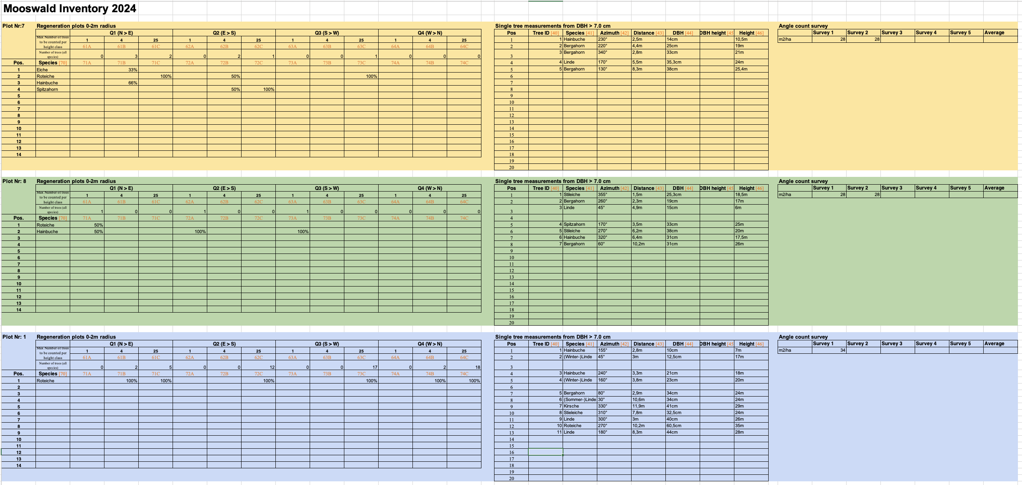
Results
What do we need for the basal area and the volume?
https://img.welt.de/img/wissenschaft/mobile252720180/6597938837-ci23x11-w2000/GettyImages-1437280725.jpg

Slide 8
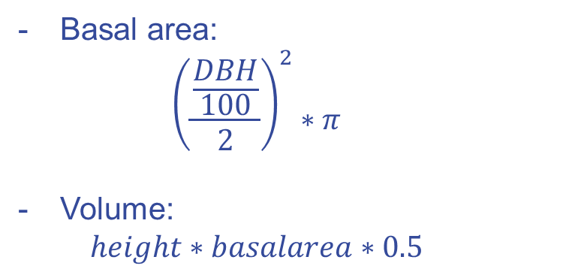
Results
Basal area:
$${\left(\frac{\frac{DBH}{100}}{2}\right)}^{2}∗π$$
Volume:
$$height∗basalarea∗0.5$$
https://img.welt.de/img/wissenschaft/mobile252720180/6597938837-ci23x11-w2000/GettyImages-1437280725.jpg

Slide 9
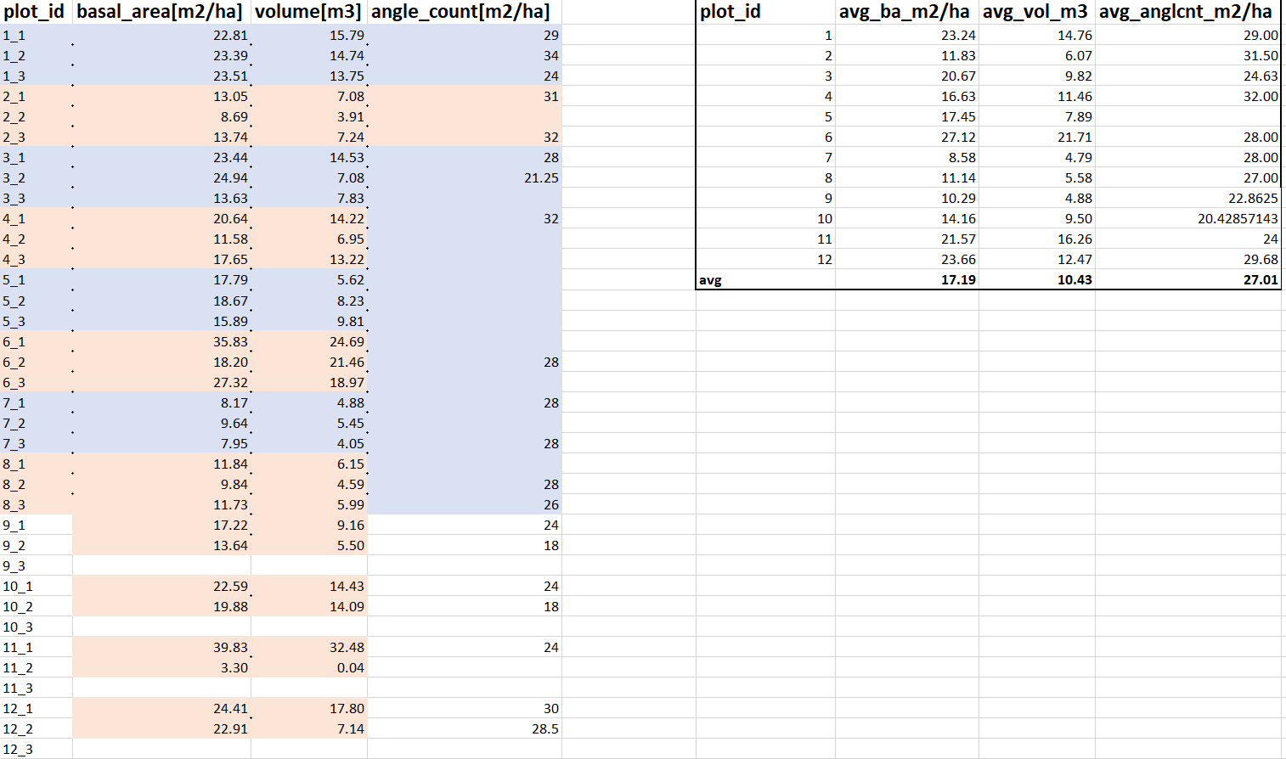
Results
https://img.welt.de/img/wissenschaft/mobile252720180/6597938837-ci23x11-w2000/GettyImages-1437280725.jpg

Slide 10
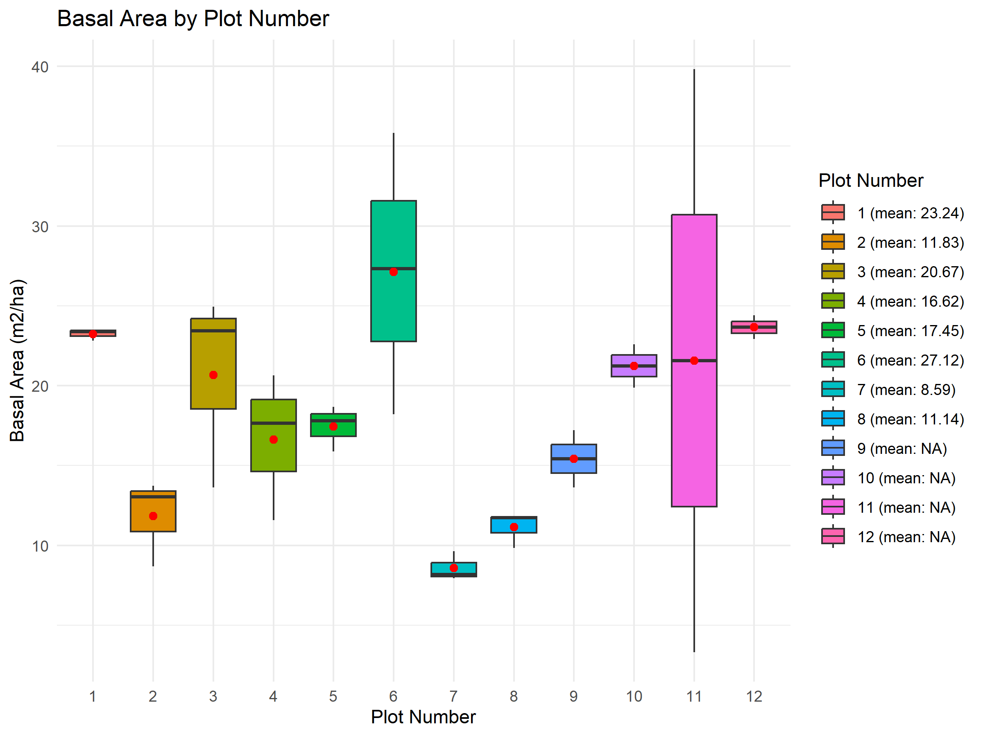
Results

Slide 11
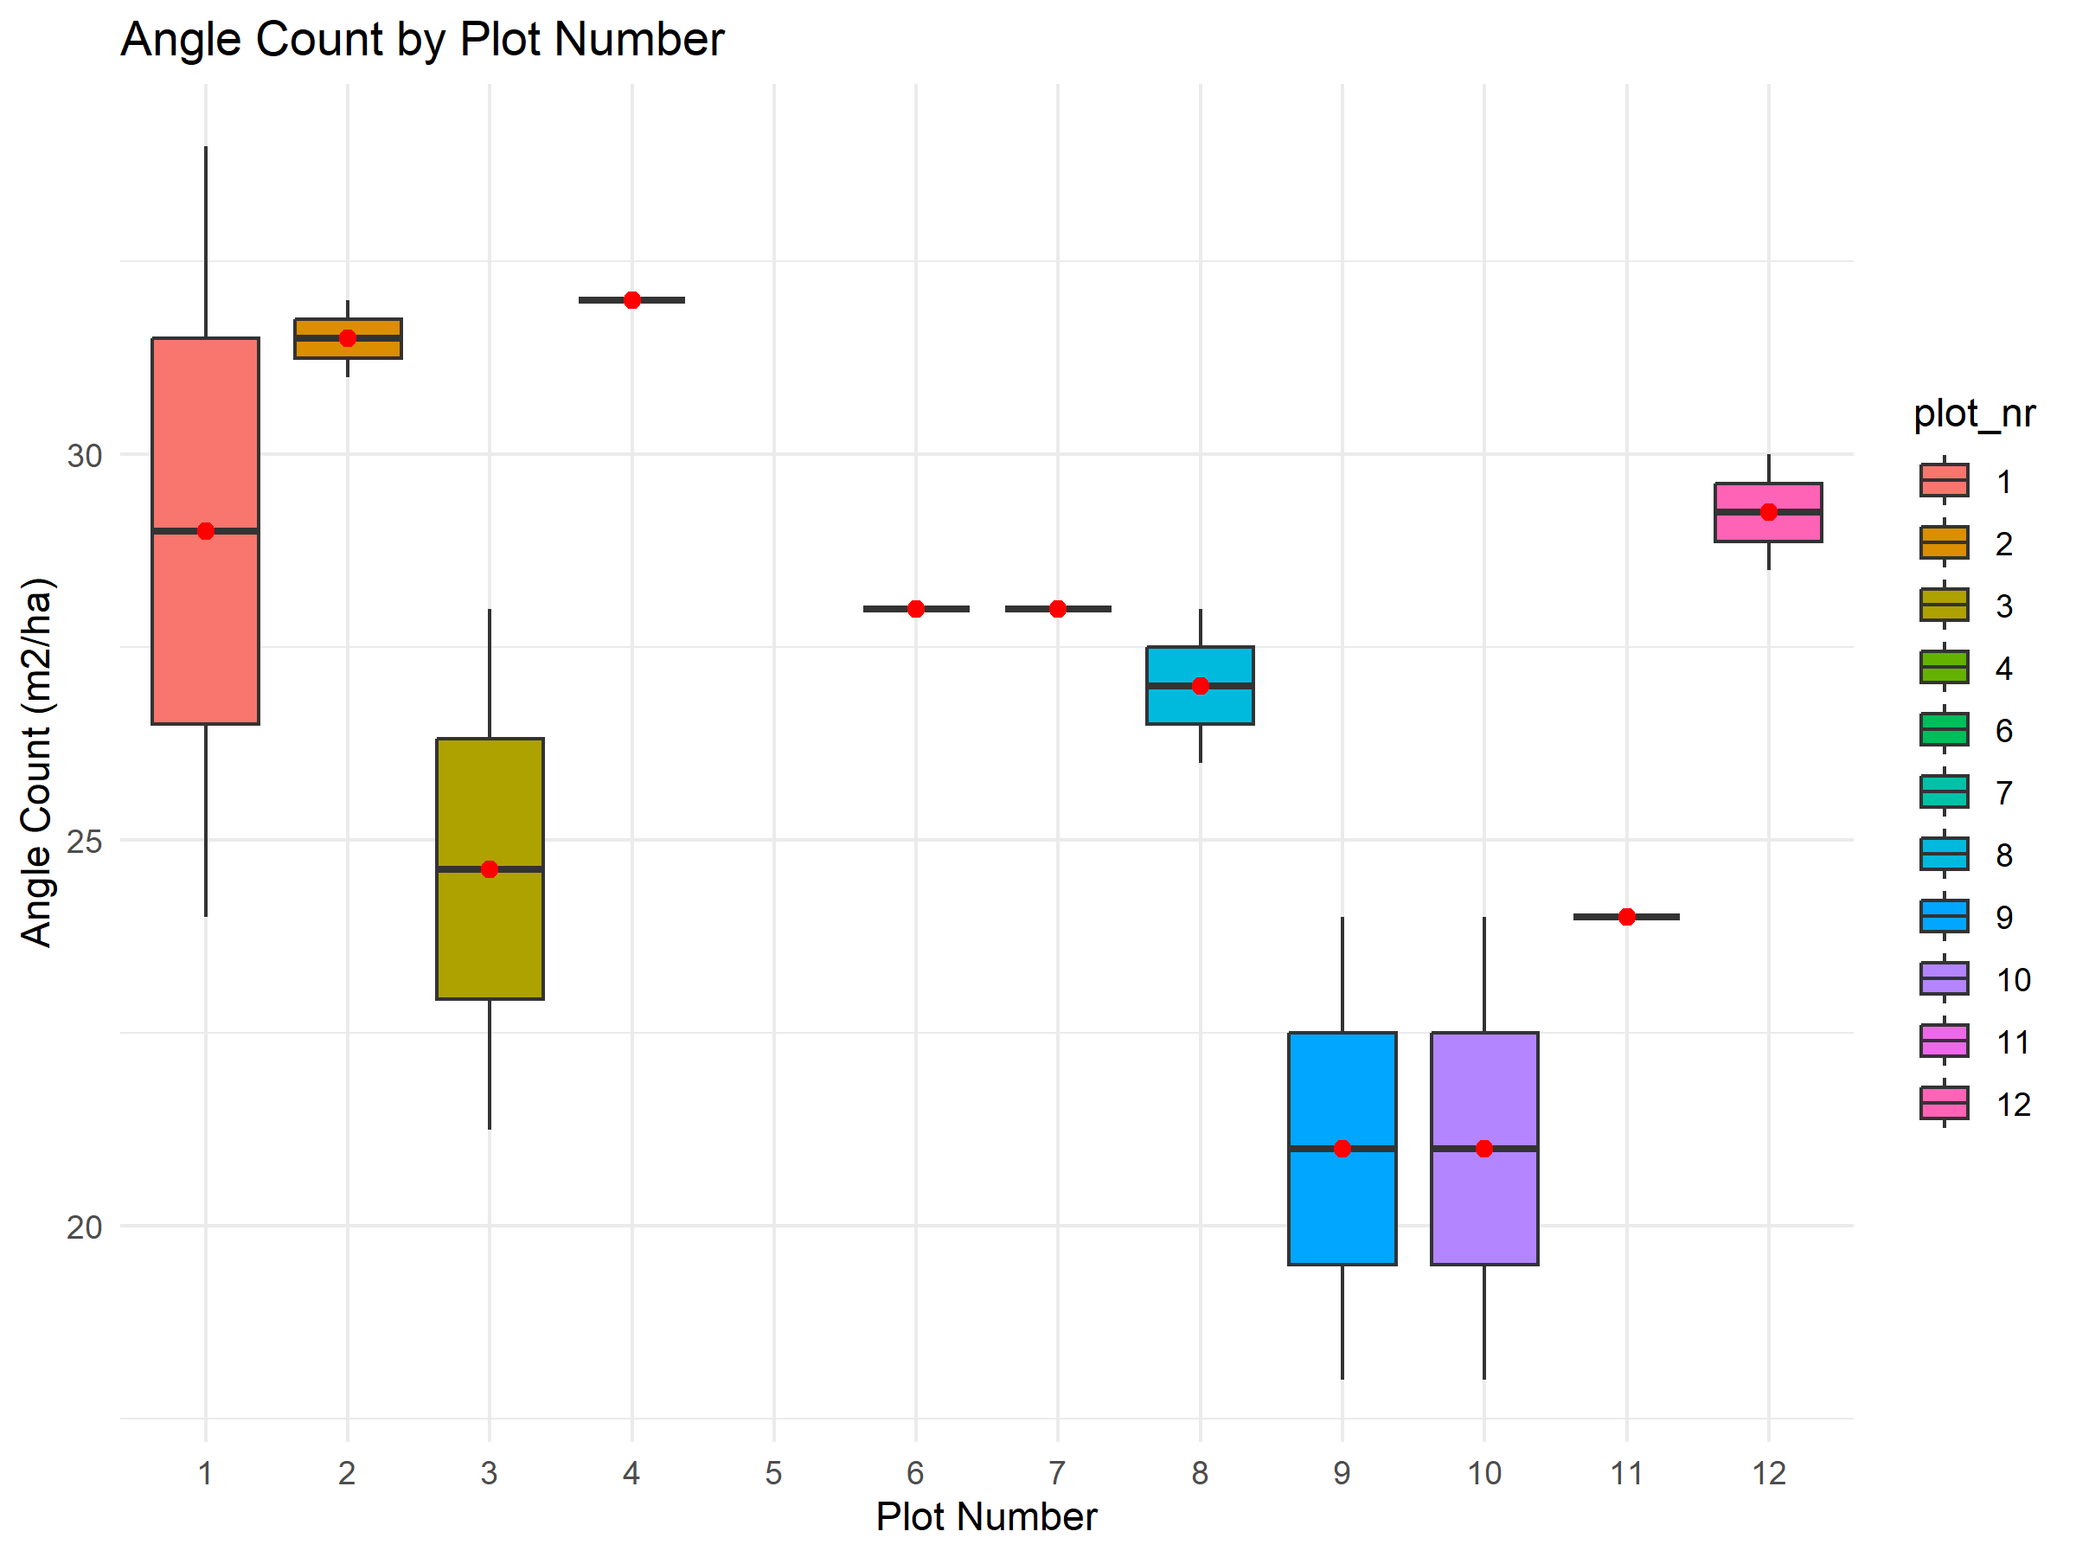
Results

Slide 12
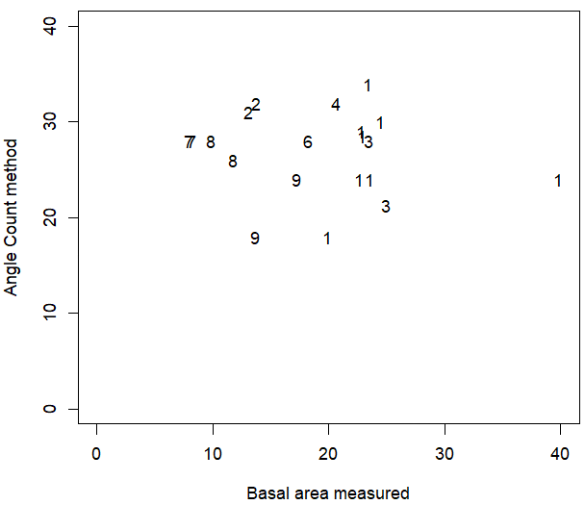
Results
Are Angle Counts and Basal area measurements correlated?
Pearson´s r-squared: -0.12
P-value: 0.6088

Slide 13
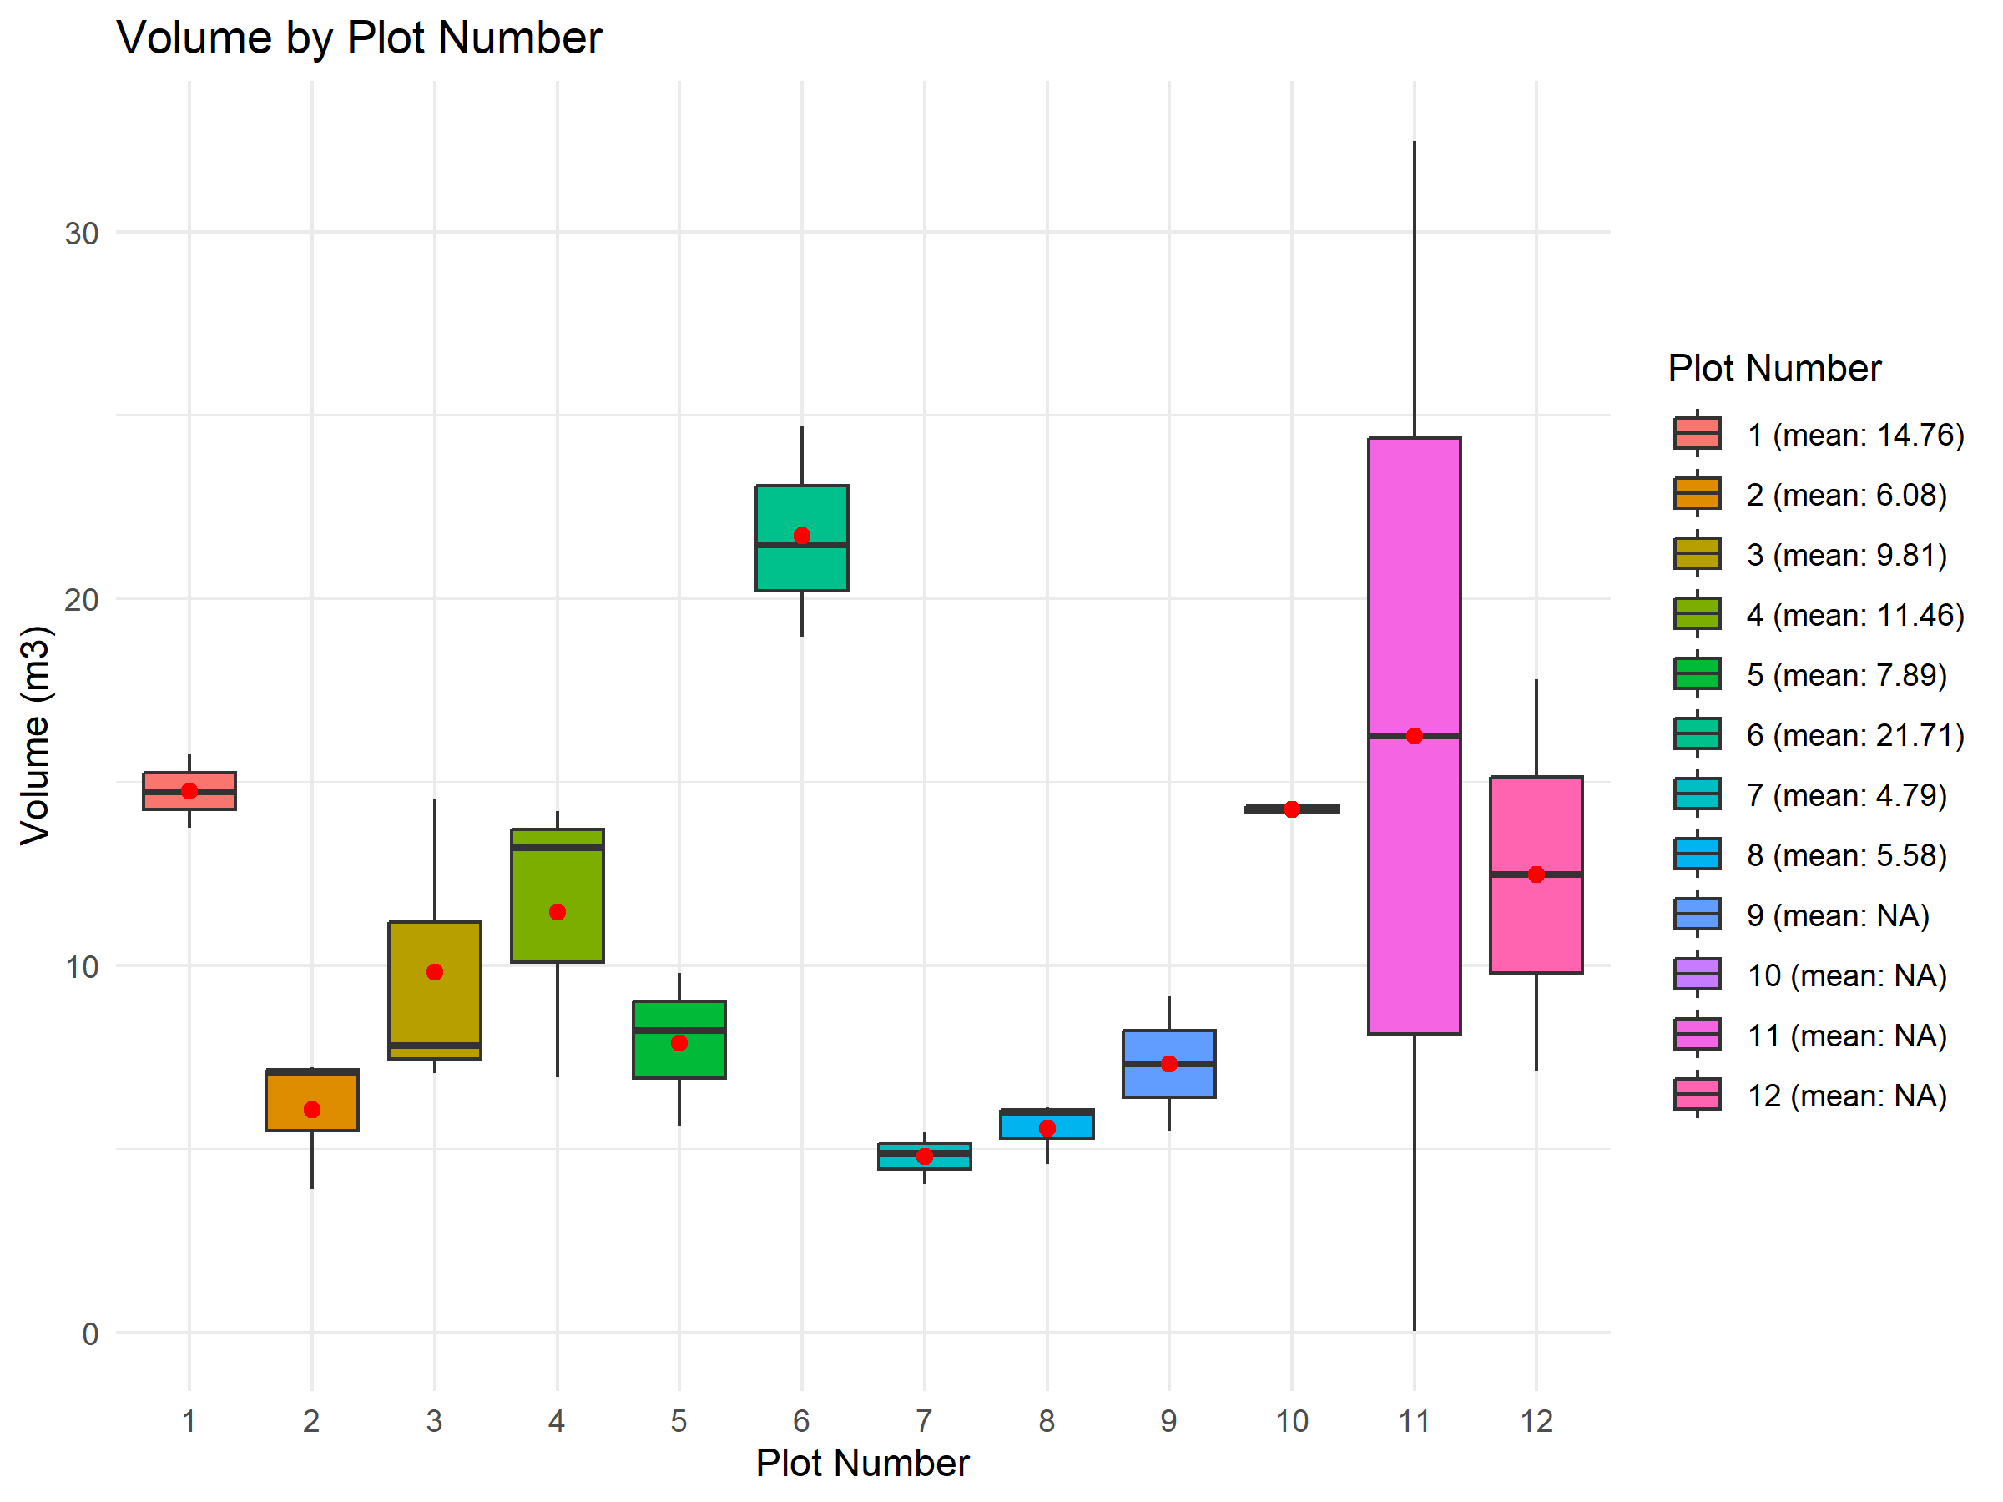
Results

Slide 14
Results

Slide 15
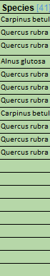
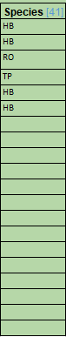
Results
We could also look at the distribution of species, but the data was too inconsistent and many were missing.
We will continue to look at this in the exercise.

Slide 16
Results
Summary
There are many uncertainties and sources of variability
The human factor plays a very significant role (who measures how accurately)
Plot selection has an extremely high influence
Different measuring instruments have different accuracies
Technqiues also differ (actual survey vs. Angle count)

Slide 17

Results
Summary
There are many uncertainties and sources of variability
The human factor plays a very significant role (who measures how accurately)
Plot selection has an extremely high influence
Different measuring instruments have different accuracies
Technqiues also differ (actual survey vs. Angle count)
…and it takes forever

Slide 18
Introduction to sampling uncertainty

Slide 19
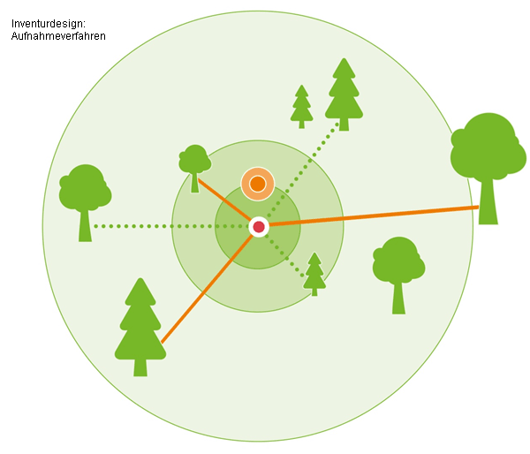
definition
Why don’t we record the entire tree population?
https://www.google.com/url?sa=i&url=https%3A%2F%2Fwww.waldwissen.net%2Fde%2Ftechnik-und-planung%2Fwaldinventur%2Feinfuehrung-in-die-bwi3&psig=AOvVaw3cej_rHtZPczaRHe_6ljko&ust=1731404386150000&source=images&cd=vfe&opi=89978449&ved=0CBQQjRxqFwoTCOjM7Iz-04kDFQAAAAAdAAAAABAE

Slide 20
definition
Why don’t we record the entire tree population?
It would simply be too time-consuming and expensive
https://www.google.com/url?sa=i&url=https%3A%2F%2Fwww.waldwissen.net%2Fde%2Ftechnik-und-planung%2Fwaldinventur%2Feinfuehrung-in-die-bwi3&psig=AOvVaw3cej_rHtZPczaRHe_6ljko&ust=1731404386150000&source=images&cd=vfe&opi=89978449&ved=0CBQQjRxqFwoTCOjM7Iz-04kDFQAAAAAdAAAAABAE

Slide 21
definition
Sampling uncertainty describes the uncertainties that result from using samples instead of full surveys.
→ what we did in the field exercise
Relevance for the forest inventory: A full inventory is almost impossible or very time-consuming… In operational forestry, we have to rely on samples.
https://www.google.com/url?sa=i&url=https%3A%2F%2Fwww.waldwissen.net%2Fde%2Ftechnik-und-planung%2Fwaldinventur%2Feinfuehrung-in-die-bwi3&psig=AOvVaw3cej_rHtZPczaRHe_6ljko&ust=1731404386150000&source=images&cd=vfe&opi=89978449&ved=0CBQQjRxqFwoTCOjM7Iz-04kDFQAAAAAdAAAAABAE

Slide 22
uncertainties
Random errors:
Unavoidable deviations, such as natural variability within the forest stand. Even if a random sample is taken, the selected area can differ greatly in its properties from the average of the entire stand, leading to inaccuracies.
Random errors from measurements
´Systematic errors:
Errors resulting from inadequate or distorted selection methods.
Faulty instruments or incorrect methods
Inadequate or faulty selection methods (e.g. biased plot selection)
Accessibility
subjective influences (e.g. human bias)
Random errors
Systematic errors

Slide 23
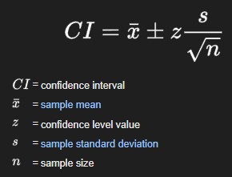
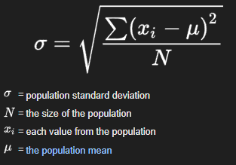
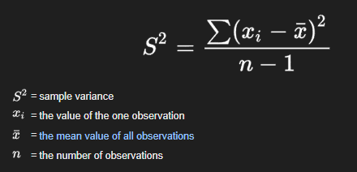
quantification of uncertainty
Confidence intervals: Range within which the true value (e.g. a mean) of the entire population lies with a certain probability (e.g. 95%).
Larger samples lead to narrower confidence intervals and thus to greater precision – but more work required.
Standard error (SE): Measure of the accuracy of the estimate to the true populatiuon parameter (e.g. a mean basal area).
Variance (S²): Spread of the individual data points around the mean (e.g. the spread of the basal area of the individual samples to the mean of all samples)

Slide 24
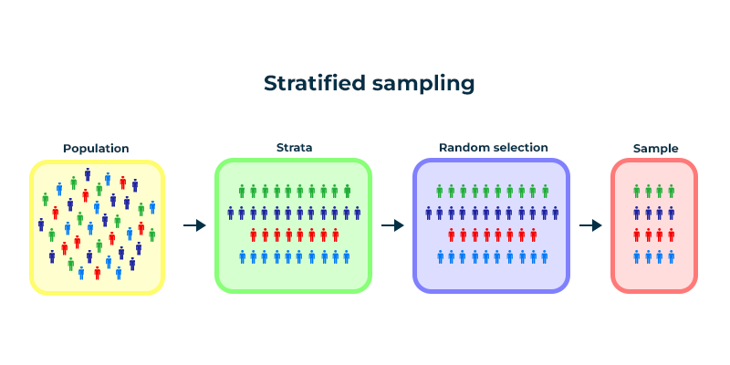
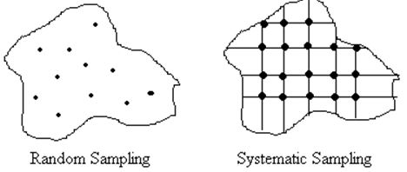
Reducing uncertainty
In general: Increase sample size - More measurement points improve accuracy and reduce uncertainty.
1) Stratified sampling: The forest is divided into homogeneous layers (e.g. by tree species or age) and separate samples are taken for each layer. This increases precision because differences between layers are taken into account.
2) Systematic sampling: Instead of randomly, samples are taken at fixed intervals, e.g. every 100 meters along a grid. This method can ensure better coverage and more even distribution.
https://www.google.com/url?sa=i&url=https%3A%2F%2Fwww.geeksforgeeks.org%2Fstratified-random-sampling-an-overview%2F&psig=AOvVaw0-THJ857kquPKlAo4HLk5t&ust=1731586841705000&source=images&cd=vfe&opi=89978449&ved=0CBQQjRxqFwoTCJjrreal2YkDFQAAAAAdAAAAABA4
https://www.google.com/url?sa=i&url=https%3A%2F%2Fforestrypedia.com%2Fthe-forest-resource%2F&psig=AOvVaw2iWvngqhGBn08rVFWvlw_w&ust=1731586906681000&source=images&cd=vfe&opi=89978449&ved=0CBQQjRxqFwoTCMCLpYmm2YkDFQAAAAAdAAAAABAE

Slide 25
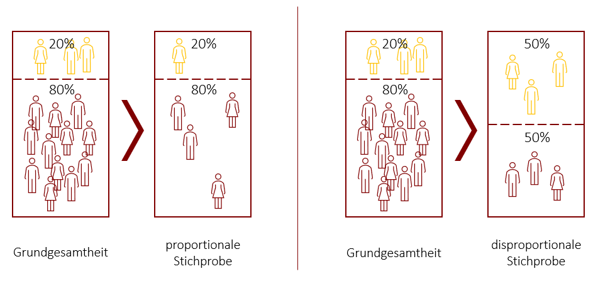
reducing uncertainty
1) Example forest:
Stock 80% beech, 20% spruce
→ If I were to represent 50% spruce in my sample, I would have a distorted image of the entire forest stock.
Whole data
Proportional sample
Whole data
disproportional sample

Slide 26
Summary
We now know
... what sampling uncertainty is
... why it is important for forest inventories
... that there are random and systematic errors
... how we can quantify these errors
... how we can address the uncertainties

Slide 27
Summary
We don't yet know
... how large these uncertainties are in a large, real forest stand
→ Exercise in R

Slide 28
Questions?
What questions do you have so far?

Slide 29
Transition to the exercise in R
We will now simulate one or more samples.

Slide 30
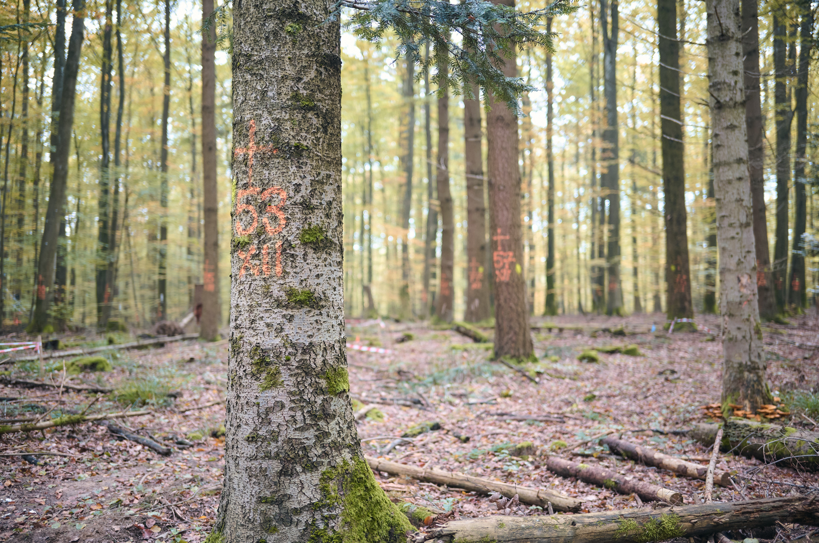
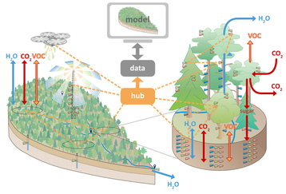
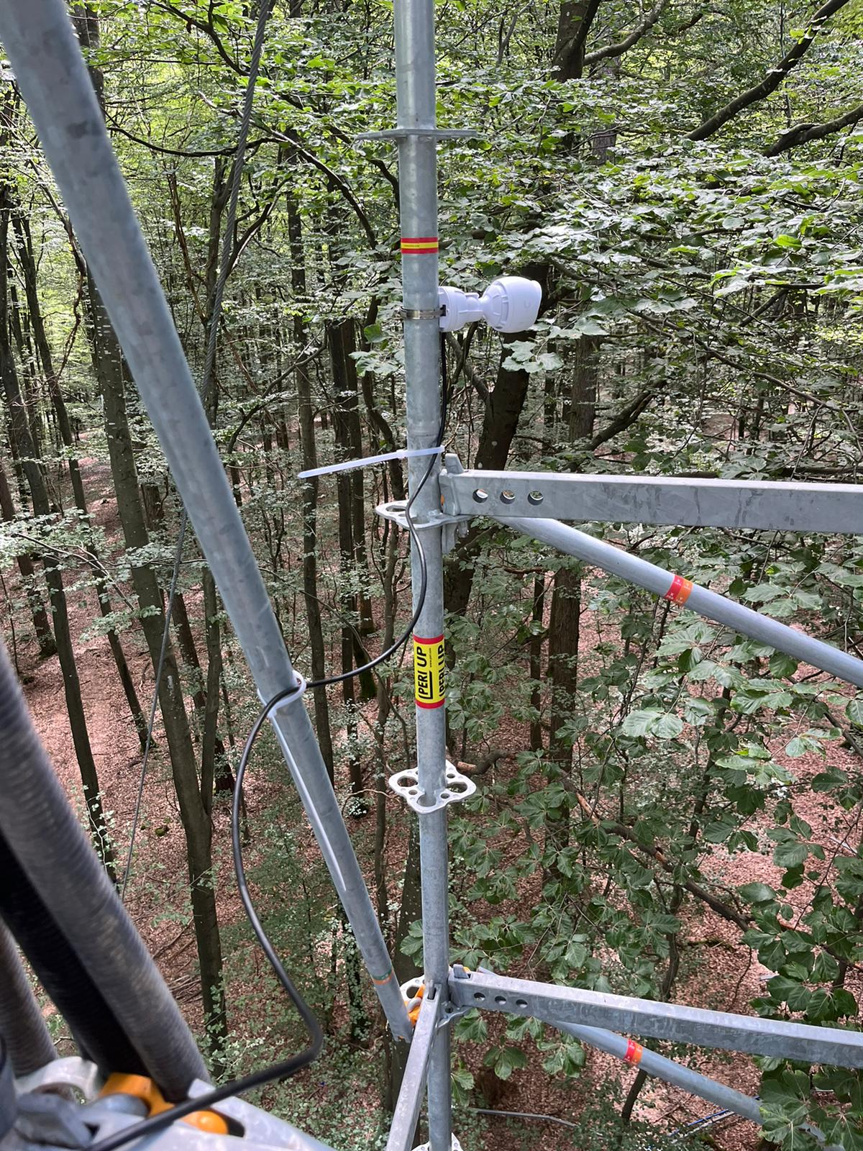
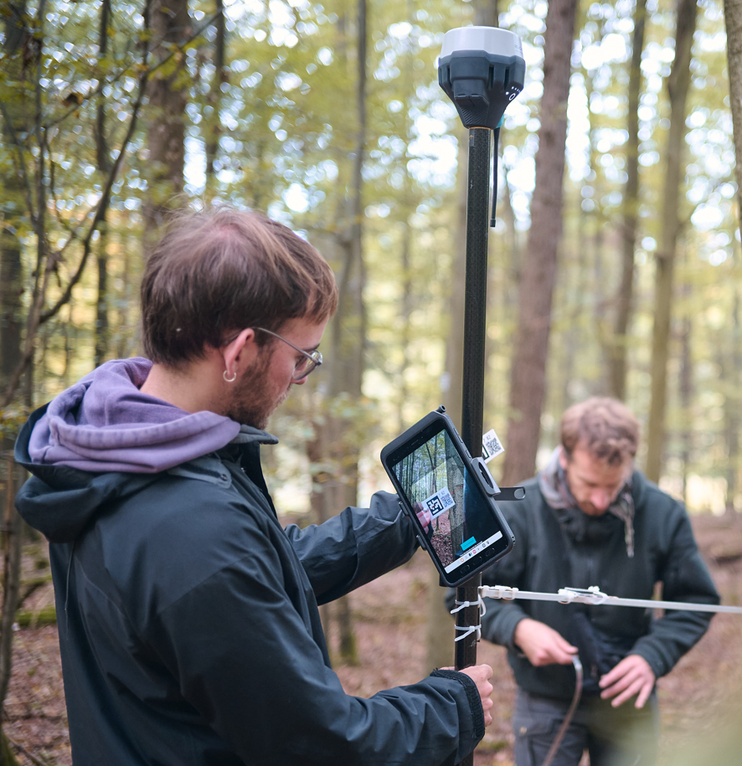
Full inventory of Ecosense https://ecosense.uni-freiburg.de/
Research site near Ettenheim
ECOSENSE researches critical ecosystem changes and develops an intelligent sensor network.
Why relevant for us? We know each tree on this site on the basis of a full inventory.

Slide 31
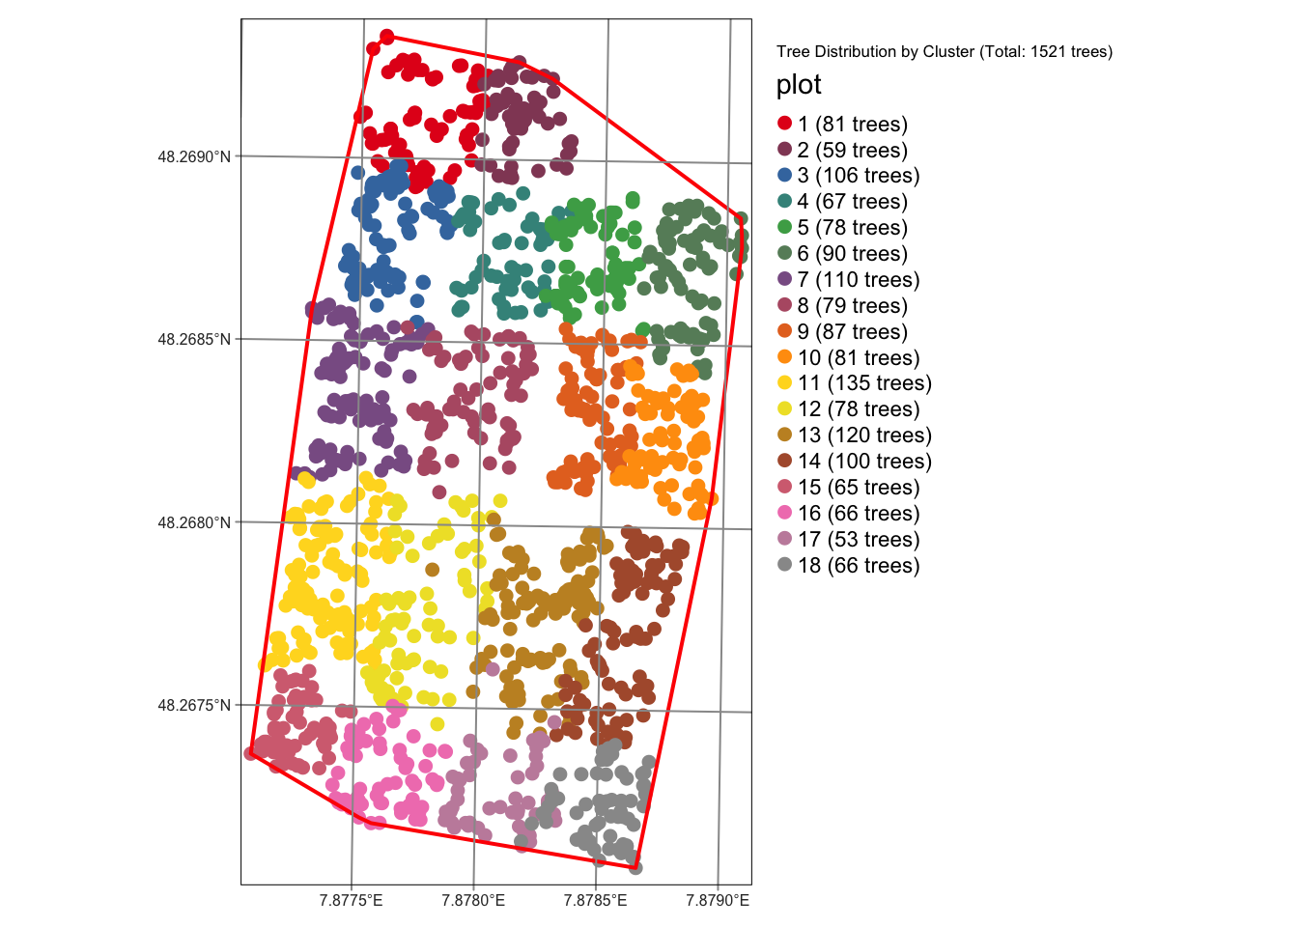
Full inventory of Ecosense https://ecosense.uni-freiburg.de/
Download the file ex05-pw.zip and unpack the data where you can find it again.
Password is: Inventory
Open the .qmd file in Rstudio
The geopackage contains tree coordinates, as well as many other attributes of 1521 trees

Slide 32
What exactly are we doing today
Basic statistics
Simulate sampling
random sampling and regular grid
“real scenario”
Influence of GNSS uncertainty to Plot measurements

Slide 33
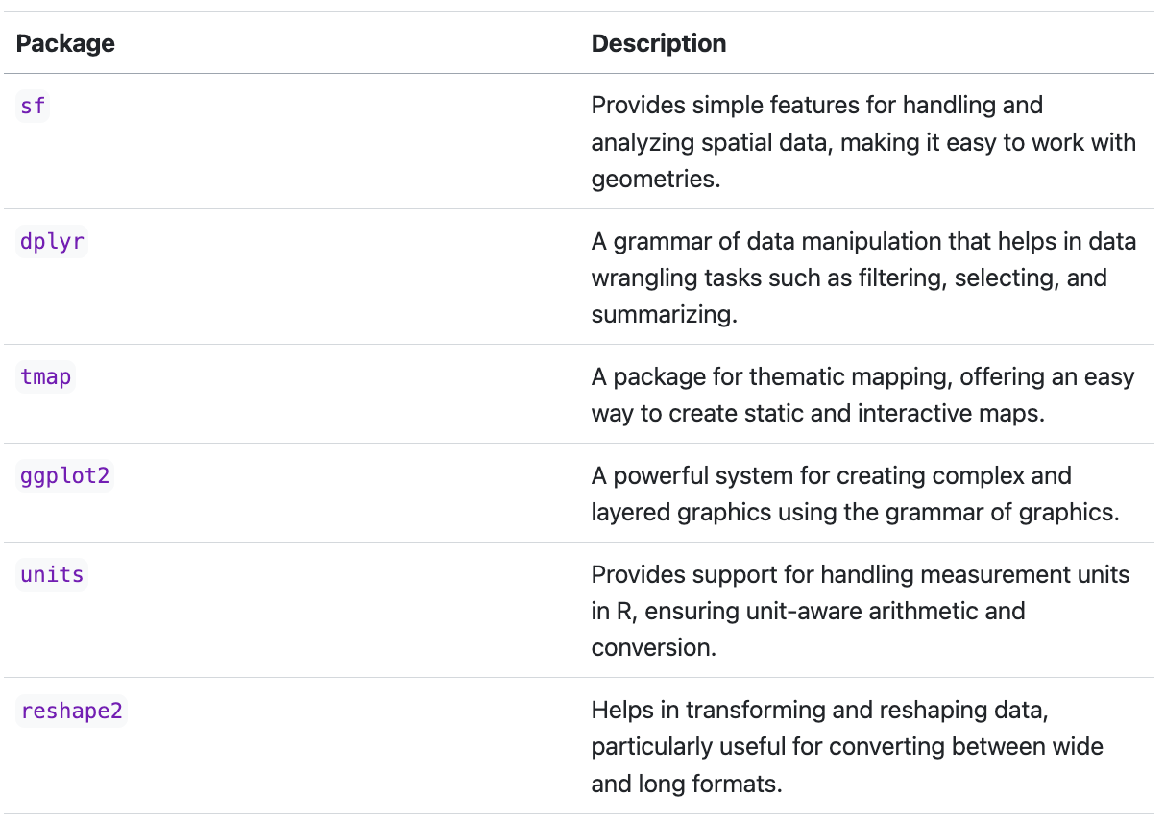
Small refresher of the required packages in R
Working with geodata →
General feature handling
- buffer, clip etc.
Working with geodata →
Nice tool for creating maps

Slide 34
dplyr
tree data
gruppieren
summe
# Calculate number of trees per cluster/plot
trees_per_plot <- tree_inventory_data %>%
group_by(plot) %>%
summarize(tree_count = n())
This section of code uses the %>% operator
The operator enables what is known as pipelining, a concept in which the output of one function is passed directly as input to the next function.

Slide 35
sf package
# Read a specific layer from the GeoPackage
tree_inventory_data <- st_read("tree_inv_ike.gpkg", layer = "datasheet_ecosense2023")
The sf package in R is used for working with spatial (geographical) data.
Geodata analysis
based on the Simple Features Standard

Slide 36
sf package
1. Import and export data
st_read() and st_write(): Imports/exports spatial data in various formats, e.g. shapefiles, GeoJSON, KML.
2. Create and manipulate geometries
st_point(), st_linestring(), st_polygon(): Creates points, lines and polygons.
st_geometry(): Extracts or sets the geometry column in an sf object.
st_union(), st_intersection(), st_difference(): Performs geometry operations such as union, intersection or difference.
3. Spatial calculations
st_area(), st_length(), st_distance(): Calculates area, length and distance of geometric objects.
st_centroid(): Calculates the center of polygons.
4. Transformations and projections
st_transform(): Changes the projection of a spatial object (e.g. from geographic coordinates to a Cartesian projection).
st_crs(): Sets or returns the coordinate system.
5. Processing and analyzing data
st_join(): Combines two sf objects based on spatial relationships (e.g. within, overlapping).
st_buffer(): Creates a buffer around geometries.

Slide 37
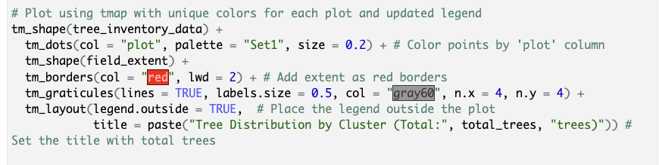
tmap package
tm_shape(): Sets the data basis for the map (e.g. point or area data), which is then visualized in further steps.
+ tm_dots(): Draws points for each tree position and colors them according to the "plot" value, so that each group gets a different color.
+ tm_borders(): Adds a border line around the shape data (e.g. the study area), here red and slightly thicker.
+ tm_graticules(): Adds a grid to the map, which creates orientation and reference points in the background.
+ tm_layout(): Adjusts the layout, e.g. placing the legend outside the map and setting a title with the total number of trees.

Slide 38
ggplot2 package
ggplot2 is a powerful and flexible R package for data visualization based on the concept of the so-called Grammar of Graphics.
→ Modularly customizable (similar to tmap)
Basic structure:
ggplot(data = <data>) +
aes(x = <X-axis variable>, y = <Y-axis variable>) +
geom_<type>() +
theme() +
labs()
Points, polygons, boxplot, etc.
fonts etc.
Labels/Text

Slide 39
Switch to Rstudio (if you want)
Now we will look at the exercise in Rstudio
Basic structure of the document:
- Loading and viewing data, using sf and tmap packages
- Statistics about the forest cover (basal area, species, DBH)
- Plot selection and uncertainties
- Simulation
- Questions to answer (woohoo)

Slide 40
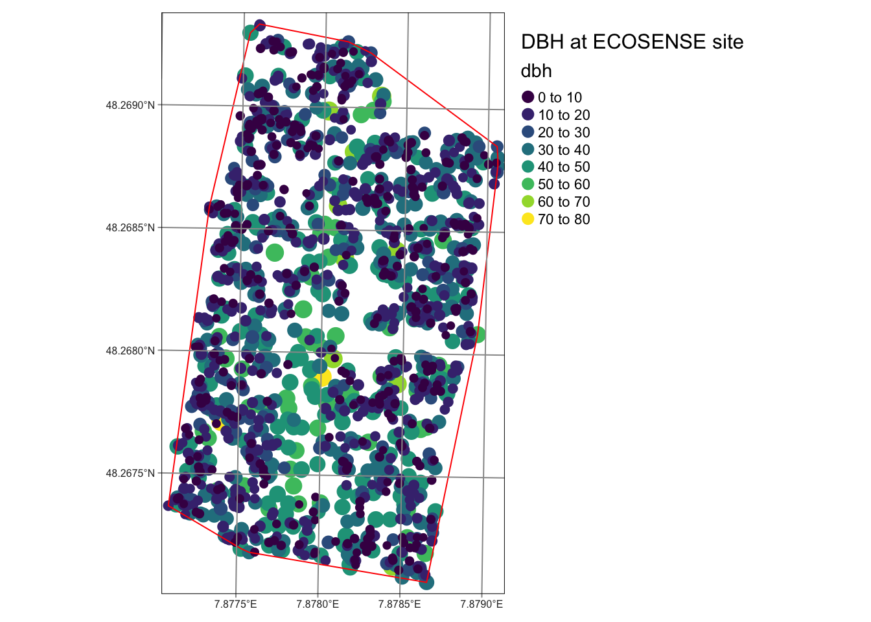
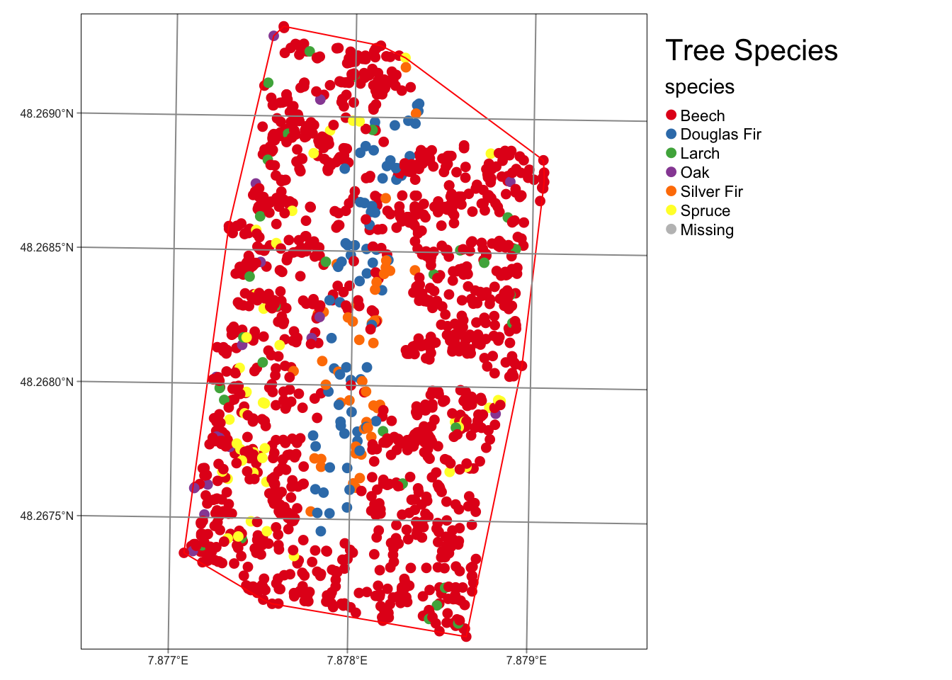
Viewing data in R
What do we see?

Slide 41
Viewing data in R
Right Small trees outside, large trees in the middle
Many beeches, many Douglas firs

Slide 42
Viewing data in R
Think back to the exercise – which option would (probably) be the more meaningful:
1
2

Slide 43
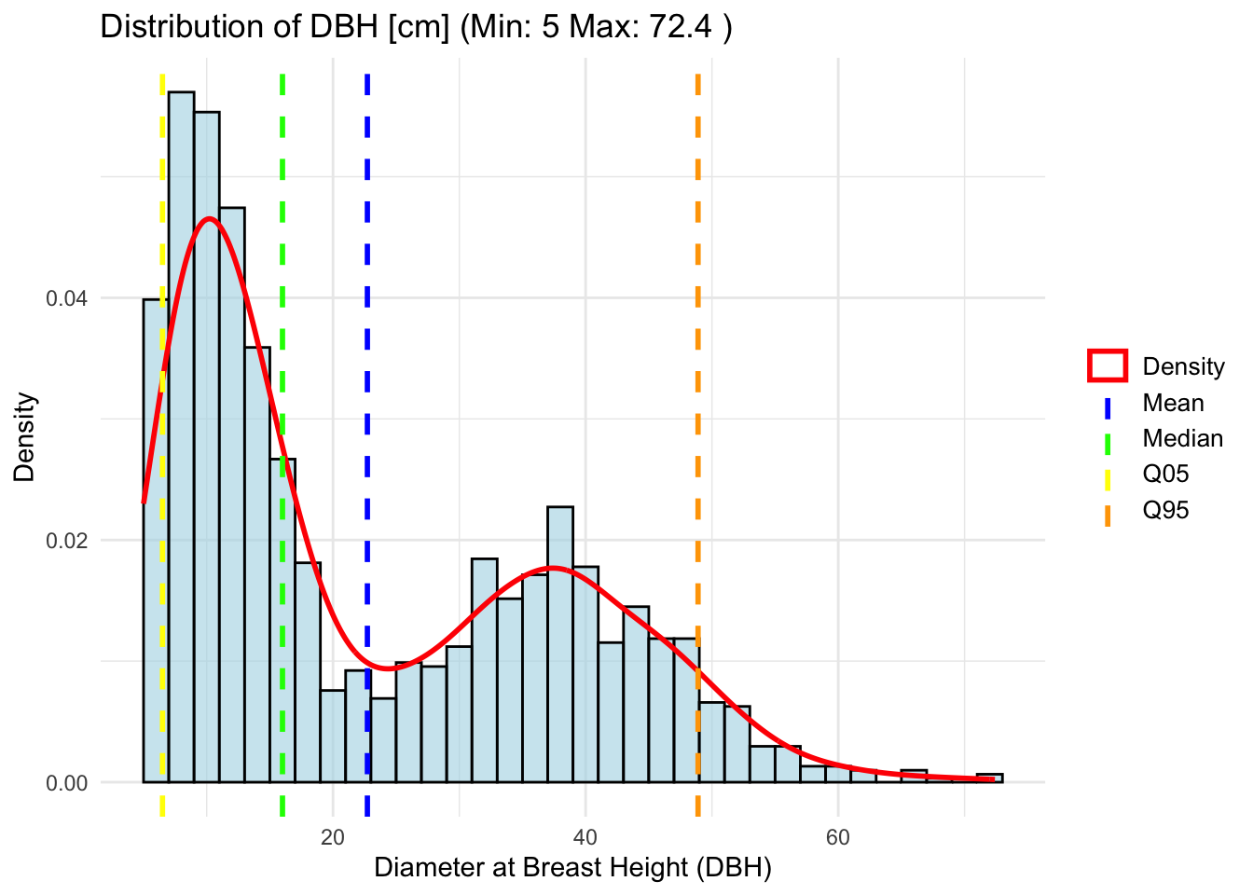
Viewing data in R
What does this graphic tell us?
Small trees? Big trees? Well distributed? Young or old forest?

Slide 44
Viewing data in R
Bimodal distribution of trees
Hence high deviations from the average
Base area calculated from this: 31.68 m2/ha

Slide 45
Viewing data in R
Distribution and significance of DBH (cm):
Mean (22.72) vs Median (16): Median lower than the mean, indicating right-skewed distribution.
Mode (9): Most frequent value, lower than mean and median, also supports right-skewed distribution.
Standard deviation (14.89): Measure of dispersion around the mean; high value indicates variability.
IQR (25.9): Range of the middle 50% of the data; large value compared to the median indicates wide range of values.
Summary: The distribution is right-skewed (mean > median > mode) with high variability (high standard deviation and IQR).
→ A few very large values/trees

Slide 46
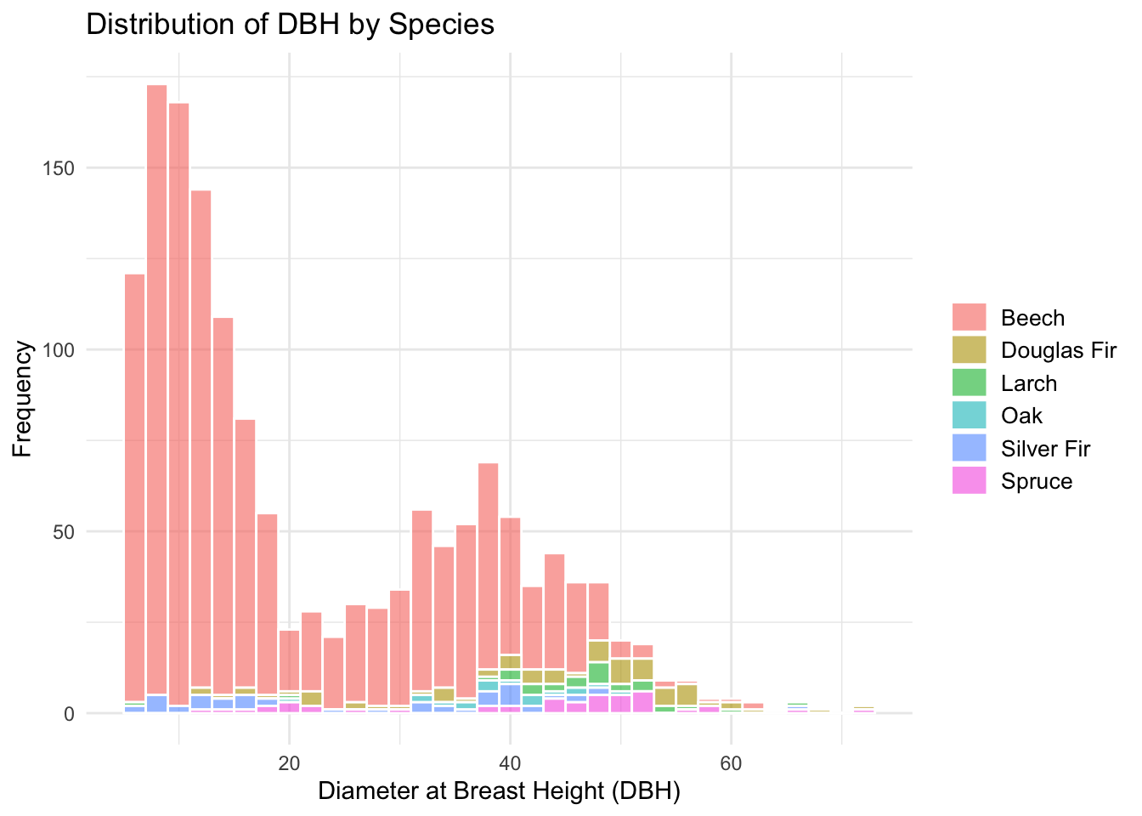
Viewing data in R
Species distribution
What does this graph show us?
What do you notice?

Slide 47
Viewing data in R
Species distribution
Colors are relative to the entire stand
Many young beeches
Some larger oaks, Douglas firs and larches
…

Slide 48
Rest in the exercise in the afternoon
We will simulate one or more samples.

Slide 49
Viewing data in R Simulation of samples – Random sampling and regular grid
Simulation
Random points
Regular grid
We do 2 simulations and see what happens:
1. Random plots
2. Regular grid
In the example, we take a sample of 10 randomly distributed points (plots) in the existing area 100 times
From this we can derive the basal area each time and see how well (or badly) we did
We do this for the 2 options of plot distribution mentioned and look at the results!

Slide 50
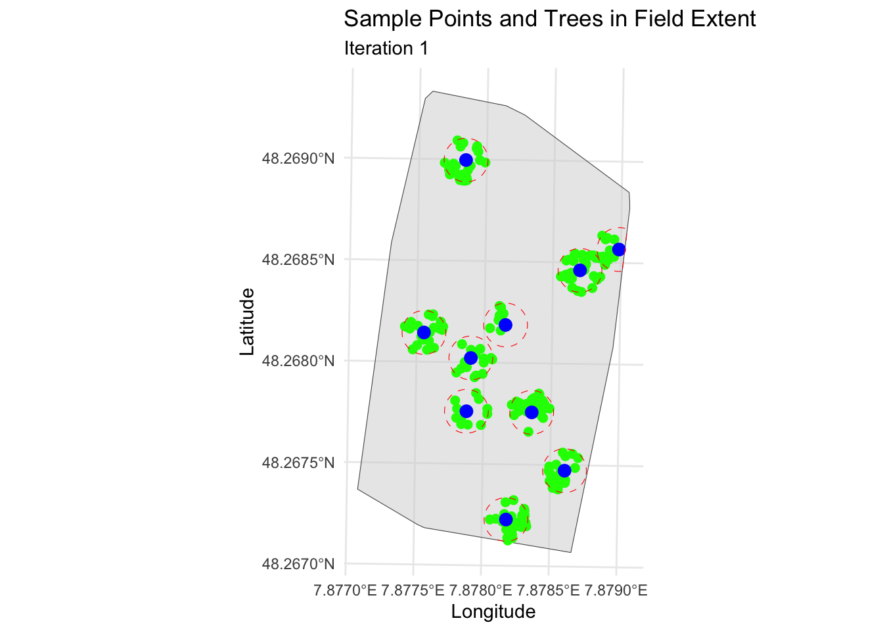
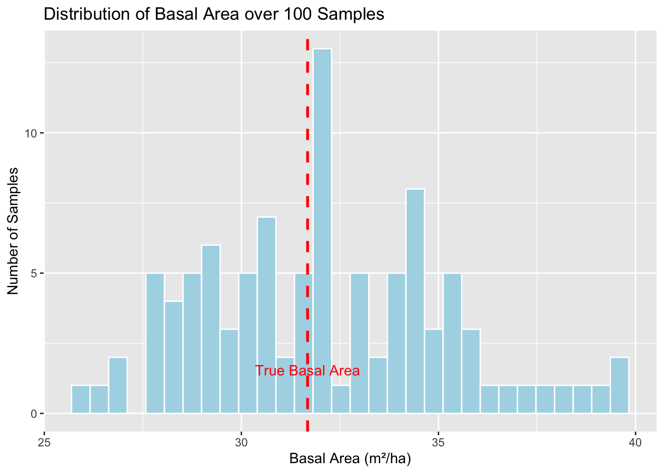
Viewing data in R Simulation of samples – Random sampling and regular grid
What do you notice? Is that good? Is that bad?
“that’s just how it is?”

Slide 51
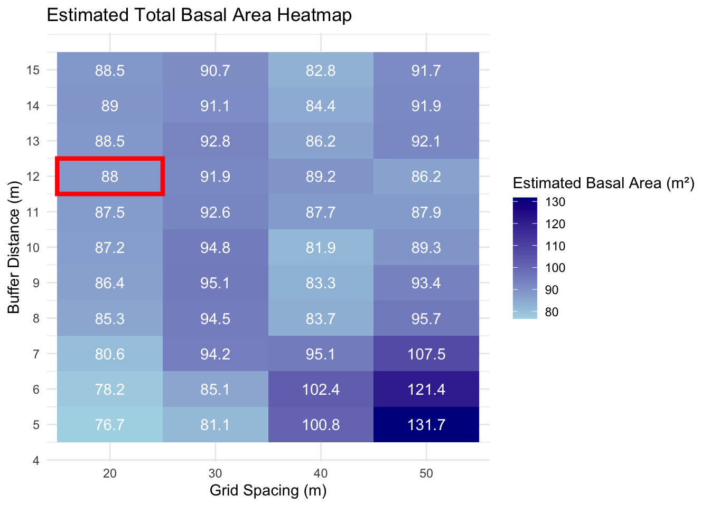
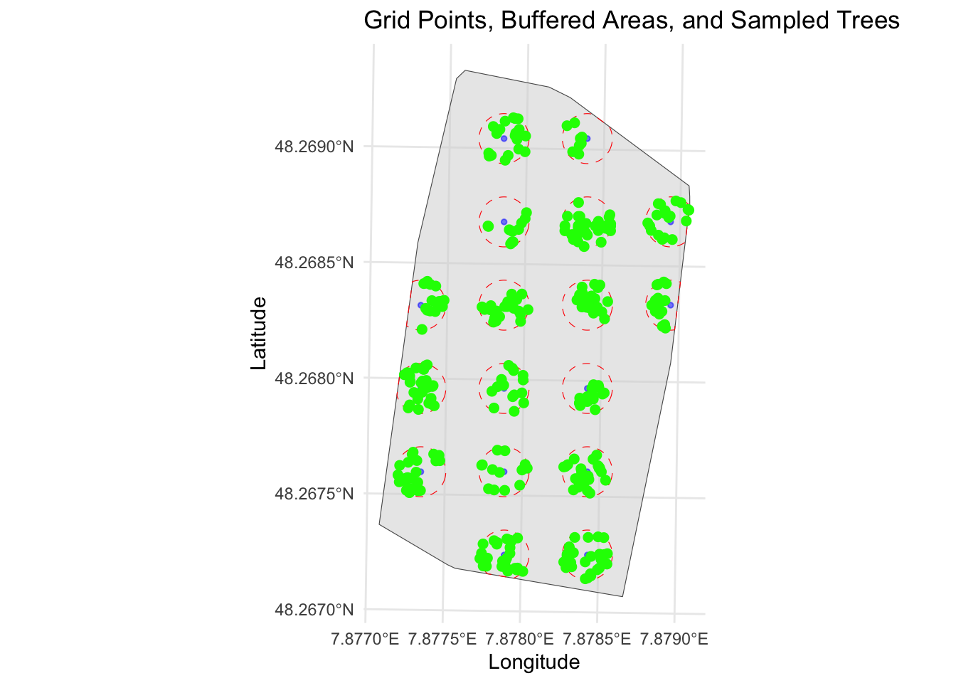
Viewing data in R Simulation of samples – Random sampling and regular grid
A regular grid is a simple and good method of getting a realistic image. Don't stick to one value (here, for example, 20/12) - this varies depending on the area and size!
There are also some extremes. It also requires a lot of work!

Slide 52
Viewing data in R “Real World Scenario“
"Imagine you go into the forest to set points whose exact coordinates have already been determined. You navigate to the locations using your smartphone or a GNSS device. But in the forest the signal jumps and you are never quite sure whether you are standing at the exact point. Nevertheless, you start measuring because "position is position", right? Later in the office you notice that the points are slightly shifted, some by as much as 2 m. This may mean that you have missed some trees that were measured in previous years. "
We simulate!
(In reality, such measuring points are precisely staked out so that the exact plot coordinates can be found again. Nevertheless, we want to know whether this is actually that serious)

Slide 53
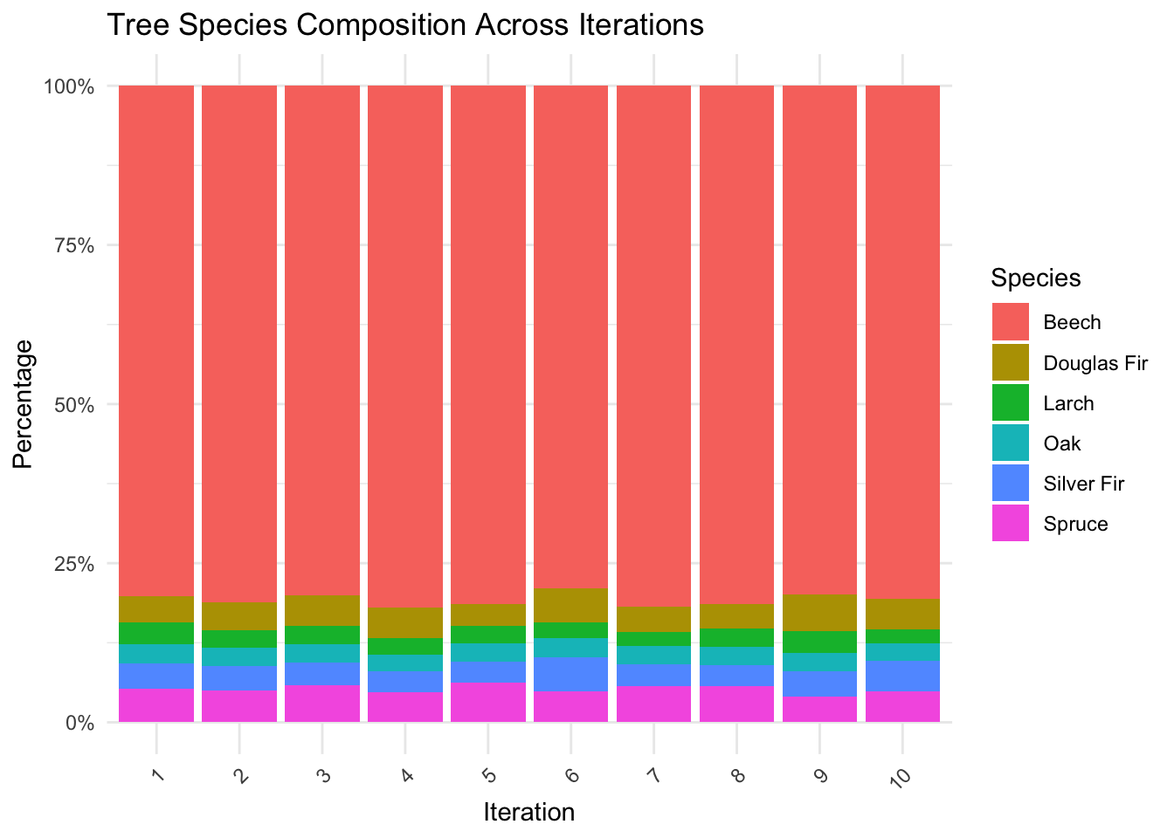
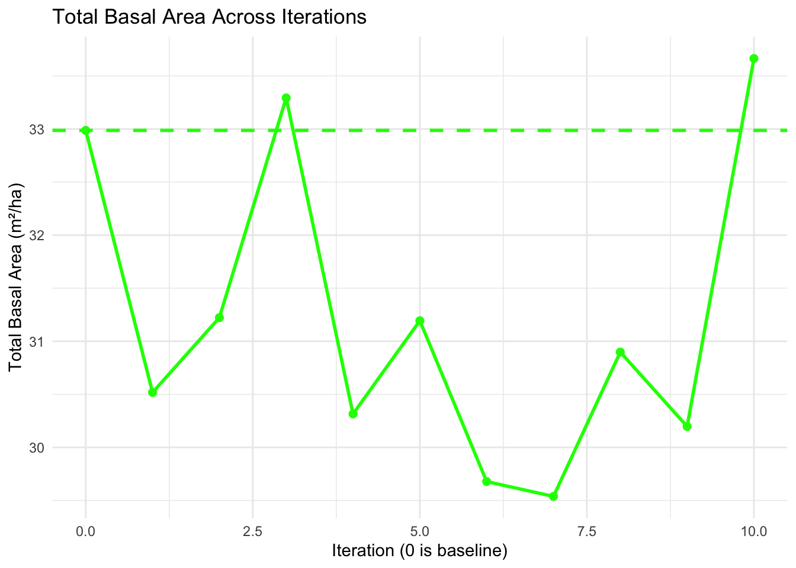
Viewing data in R Simulation of samples – GNSS uncertainties
→ Even a 2 m deviation from the actual plot has immense effects on the result

Slide 54
TAKE HOME – and what questions do you still have?
We now know
... what the Ecosense forest looks like (at least on paper)
... what sampling uncertainty is
... why this is important for forest inventories
... that there are random and systematic errors
... how we can quantify these errors
... how we can address the uncertainties
... how we can simulate forest inventories
... how we can represent geodata in R
... how we can distribute plots sensibly
... what the effects of (position-)inaccurate measurements are

